Slide 1
Artificial Neural Networks

Slide 2
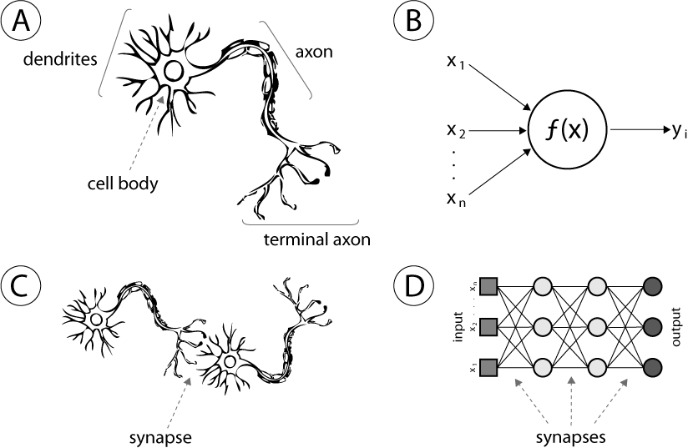
What are Artificial Neural Networks?
A computer model of the human brain
Massively parallel, distributed system, made up of simple processing units (neurons)
Synaptic connection strengths among neurons are used to store the acquired knowledge.
Knowledge is acquired by the network from its environment through a learning process

Slide 3
Properties of ANNs
Learning from examples: labeled or unlabeled
Adaptivity: changing the connection strengths to learn things
Non-linearity: the non-linear activation functions are essential
Fault tolerance: if one of the neurons or connections is damaged, the whole network still works quite well
Better alternatives than classical solutions for problems characterized by:
high dimensionality, noisy, imprecise or imperfect data; and
a lack of a clearly stated mathematical solution or algorithm

Slide 4
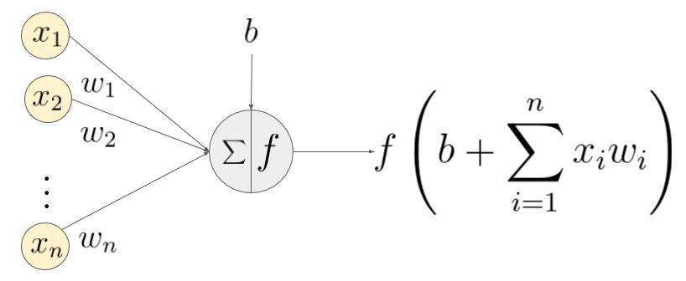
Conceptual model of an artificial neuron
Receives input from n sources
Computes weighted sum of the inputs
Adds the bias and passes through an activation function
Sends the signal to m subsequent neurons

Slide 5
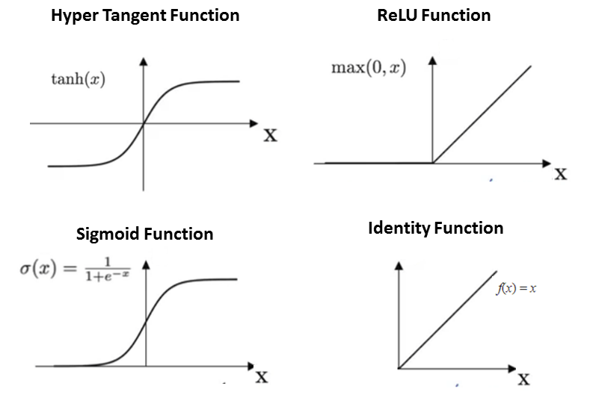
Activation functions
A function that limits the amplitude of the output of the neuron

Slide 6
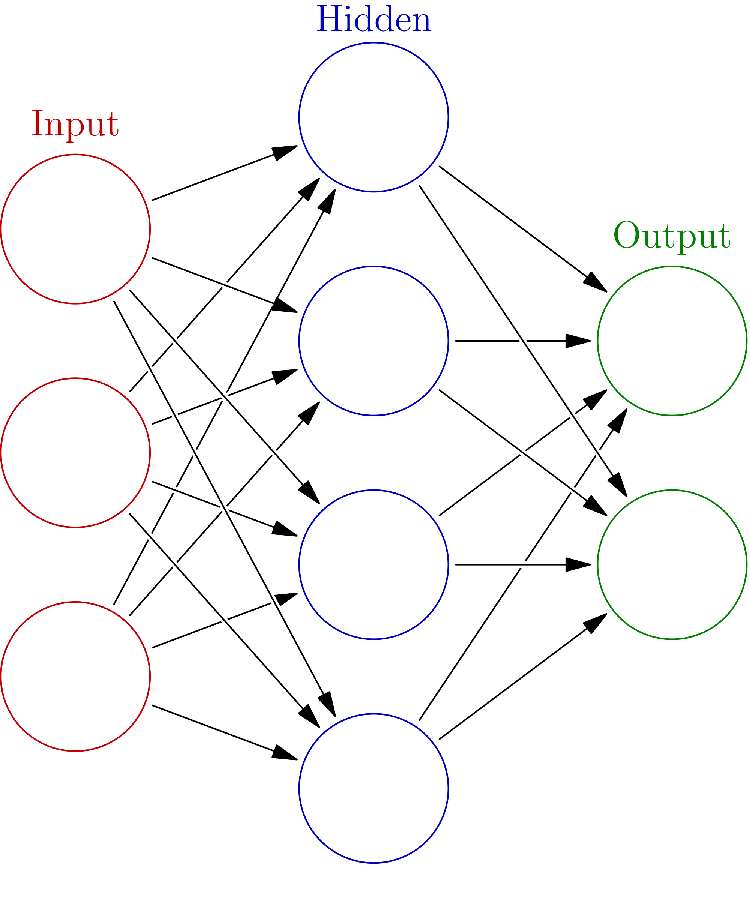
Artificial Neural Network
Layers of neurons organized as a black-box model
Different network structures
Three typical layers:
Input layer
Hidden layer
Output layer

Slide 7
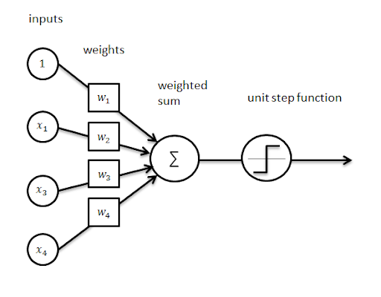
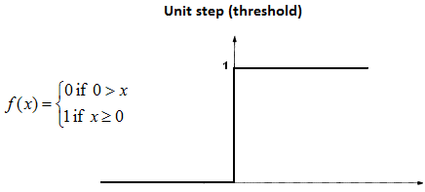
The perceptron
A linear binary classifier

Slide 8
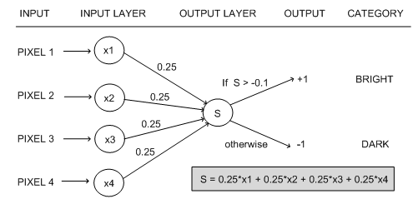
The perceptron
S=2.5 >-0.1, so the output is +1
The image categorized as BRIGHT

Slide 9
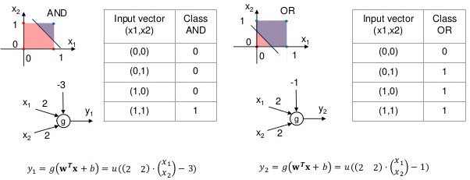
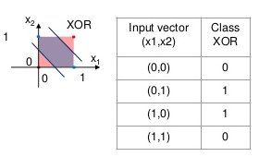
The perceptron
AND and OR can be generated using a single perceptron
XOR is a non lineary separable problem: can not be generated with a single perceptron

Slide 10
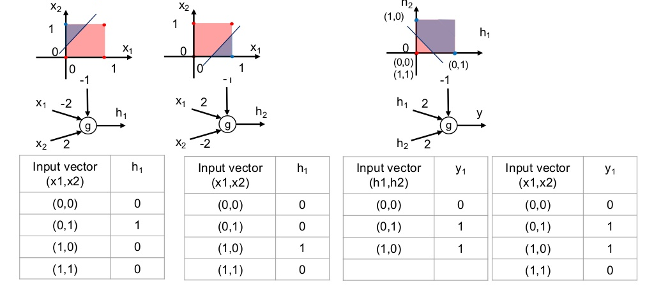
Solving the XOR problem

Slide 11
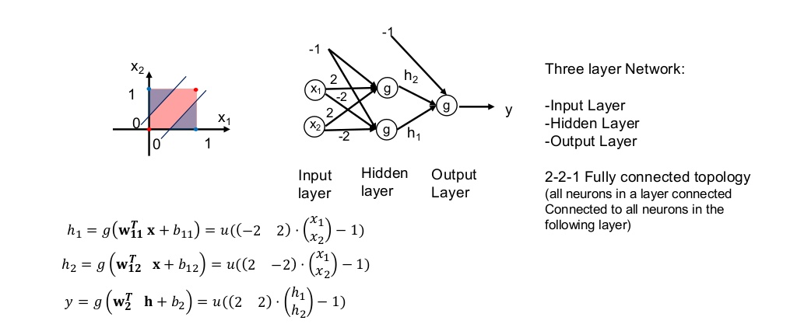
Solving the XOR problem
The MultiLayer Perceptron (MLP)

Slide 12
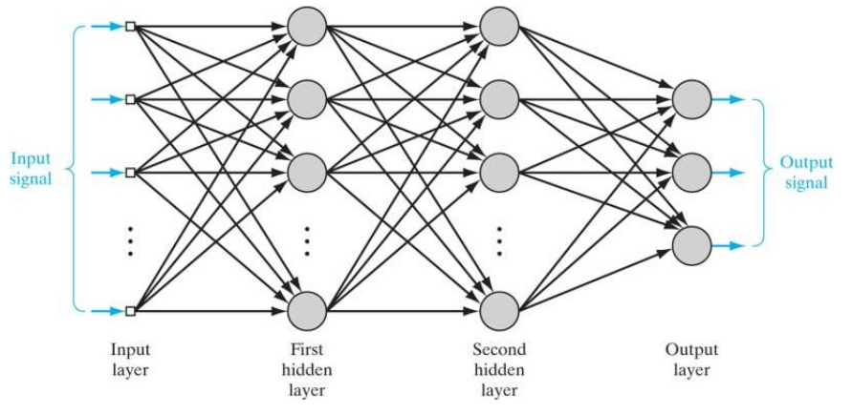
The MultiLayer Perceptron (MLP)
Stacking multiple perceptrons
Basic features of MLPs:
Each neuron in the network includes a nonlinear activation function that is differentiable.
The network contains one or more layers that are hidden from both the input and output nodes.
The network exhibits a high degree of connectivity.

Slide 13
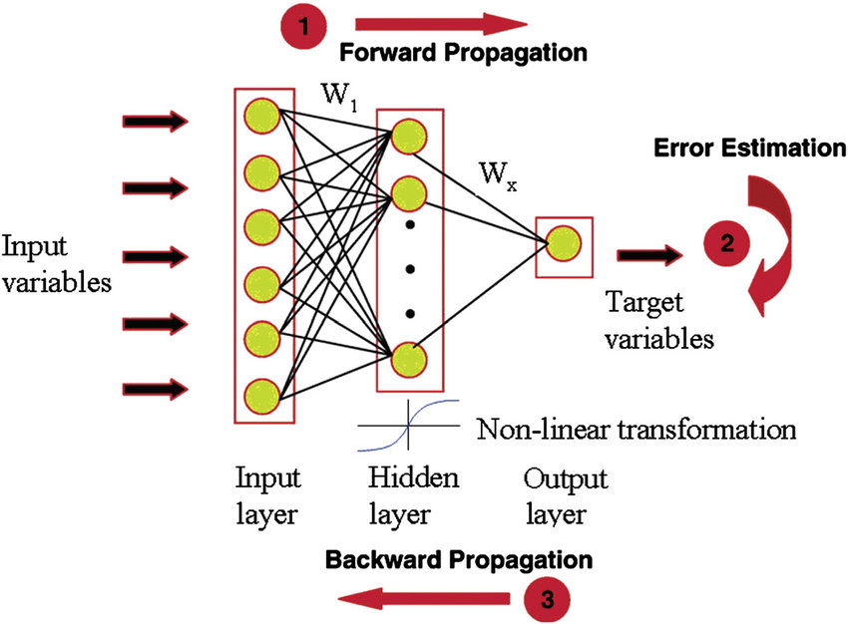
MLP training
Forward propagation: the weights are fixed and the input signal is propagated through the network layers, until it reaches the output.
Error is estimated by comparing the network output and the desired response.
Backward propagation: the error is propagated through the network layers in the backward direction

Slide 14
Gradient Descent and backpropagation
How neural networks learn?

